Slide 1

OAuth 2 Overview

Slide 2

What is OAuth 2
OAuth 2 is an authorization framework that enables applications to obtain limited access to user accounts on an HTTP service, such as Facebook, Google, Twitter, etc.
It works by delegating user authentication to the service that hosts the user account, and authorizing third-party applications to access the user account. OAuth 2 provides authorization flows for web and desktop applications, and mobile devices.

Slide 3
OAuth Roles
OAuth defines four roles:
Resource Owner
Client
Resource Server
Authorization Server

Slide 4


Resource Owner - User
The resource owner is the user who authorizes an application to access their account. The application’s access to the user’s account is limited to the “scope” of the authorization granted (e.g. read or write access).

Slide 5
Resource / Authorization Server: API
The resource server hosts the protected user accounts, and the authorization server verifies the identity of the user then issues access tokens to the application.
From an application developer’s point of view, a service’s API fulfills both the resource and authorization server roles. We will refer to both of these roles combined, as the Service or API role.

Slide 6

Client: Application
The client is the application that wants to access the user’s account. Before it may do so, it must be authorized by the user, and the authorization must be validated by the API.

Slide 7
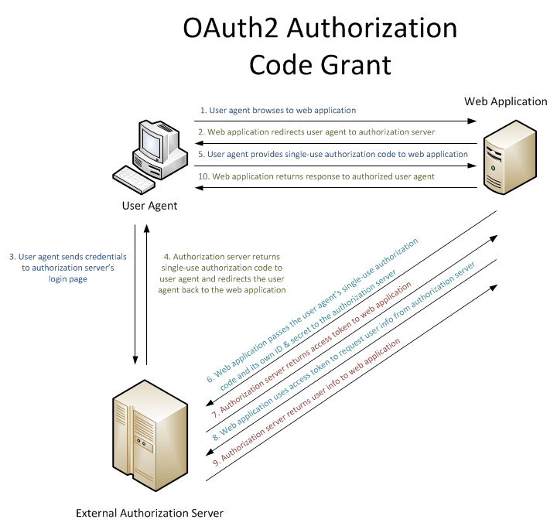

Slide 8

Learning Resources
https://oauth.net/2/
https://aaronparecki.com/oauth-2-simplified/
https://www.digitalocean.com/community/tutorials/an-introduction-to-oauth-2
https://docs.microsoft.com/en-us/aspnet/mvc/overview/security/create-an-aspnet-mvc-5-app-with-facebook-and-google-oauth2-and-openid-sign-on
https://docs.microsoft.com/en-us/aspnet/web-api/overview/security/external-authentication-services

